Slide 1
Chap 9. Distributed Systems Architectures
- Architectural design for software that executes on more than one processor -

Slide 2
Objectives
To explain the advantages and disadvantages of distributed systems architectures
To describe different approaches to the development of client-server systems
To explain the differences between client-server and distributed object architectures
To describe object request brokers and the principles underlying the CORBA standards

Slide 3
Distributed systems
Virtually all large computer-based systems are now distributed systems
Information processing is distributed over several computers rather than confined to a single machine
Distributed software engineering is now very important

Slide 4
System types
Personal systems that are not distributed and that are designed to run on a personal computer or workstation.
Embedded systems that run on a single processor or on an integrated group of processors.
Distributed systems where the system software runs on a loosely integrated group of cooperating processors linked by a network.

Slide 5
Distributed system characteristics
Resource sharing : the sharing of h/w and s/w resources that are associated with different computers on a network
Openness : the extent to which it can be extended by adding new non-proprietary resources to it
Concurrency : several process may operate at the same time
Scalability : the capabilities of the system can be increased by adding new resources
Fault tolerance : the tolerance of some h/w and s/w failures
Transparency : the concealment from the user of the distributed nature of the system

Slide 6
Distributed system disadvantages
Complexity : more complex than centralised systems, more difficult to understand emergent properties and to test the systems
Security : The system may be accessed from several computers and the traffic on the network may be subject to eavesdropping
Manageability : The computers may be of different types and may run different versions of the operating system
Unpredictability : The response depends on the overall load on the system, its organization and the network load

Slide 7
Critical Design Issues for Distributed systems
Resource identification
Communications
Quality of service
Software architectures
  Client-server architectures
  Distributed object architecture

Slide 8
Distributed systems architectures
Client-server architectures
  Distributed services which are called on by clients. Servers that provide services are treated differently from clients that use services
Distributed object architectures
  No distinction between clients and servers. Any object on the system may provide and use services from other objects

Slide 9
Middleware
Software that manages and supports the different components of a distributed system. In essence, it sits in the middle of the system
Middleware is usually off-the-shelf rather than specially written software
Examples
  Transaction processing monitors
  Data converters
  Communication controllers

Slide 10
Multiprocessor architectures
Simplest distributed system model
System composed of multiple processes which may (but need not) execute on different processors
Architectural model of many large real-time systems
Distribution of process to processor may be pre-ordered(in critical systems) or may be under the control of a despatcher

Slide 11
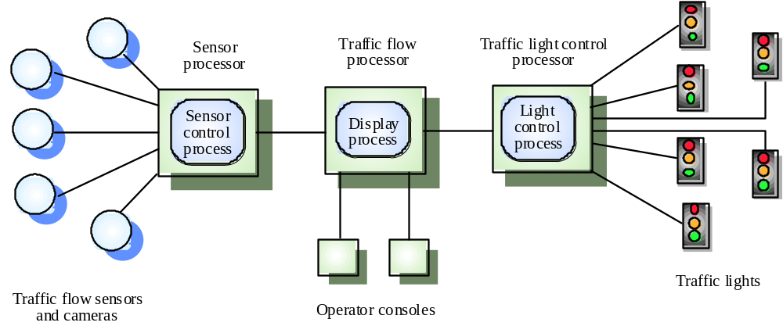
A multiprocessor traffic control system

Slide 12
Client-server architectures
The application is modelled as a set of services that are provided by servers and a set of clients that use these services
Clients know of servers but servers need not know of clients
Clients and servers are logical processes
The mapping of processors to processes is not necessarily 1 : 1

Slide 13
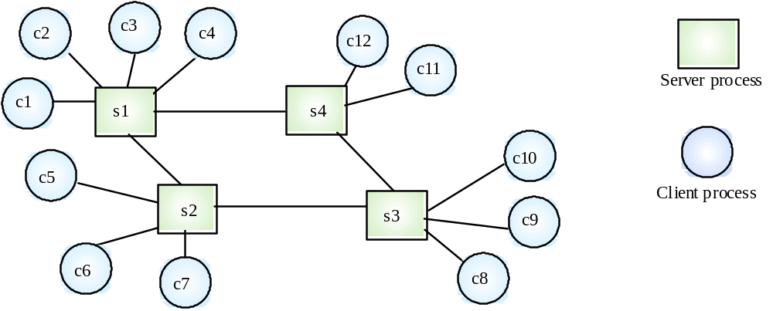
A client-server system
< Logical processes >

Slide 14
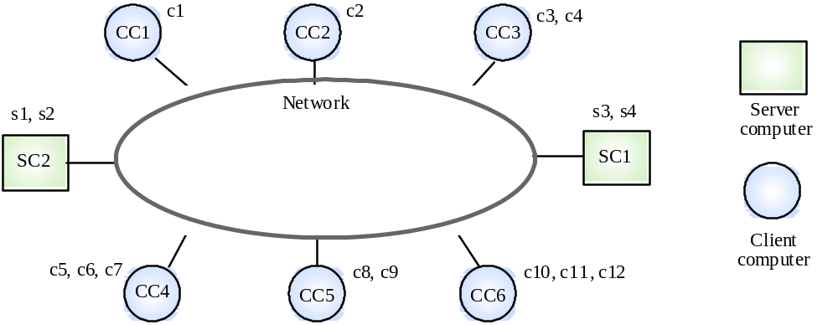
Computers in a C/S network
< Physical architecture >

Slide 15
Layered application architecture
Presentation layer
  Concerned with presenting the results of a computation to system users and with collecting user inputs
Application processing layer
  Concerned with providing application specific functionality e.g., in a banking system, banking functions such as open account, close account, etc.
Data management layer
  Concerned with managing the system databases

Slide 16
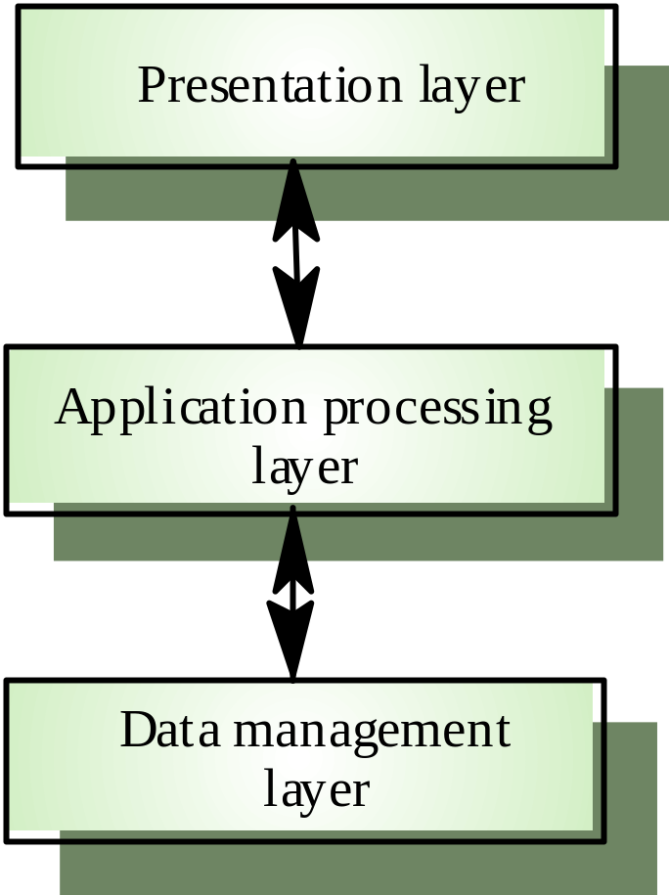
Application layers

Slide 17
Thin and fat clients
Two-tier client-server architectures
Thin-client model
  In a thin-client model, all of the application processing and data management is carried out on the server. The client is simply responsible for running the presentation software.
Fat-client model
  In this model, the server is only responsible for data management. The software on the client implements the application logic and the interactions with the system user.

Slide 18
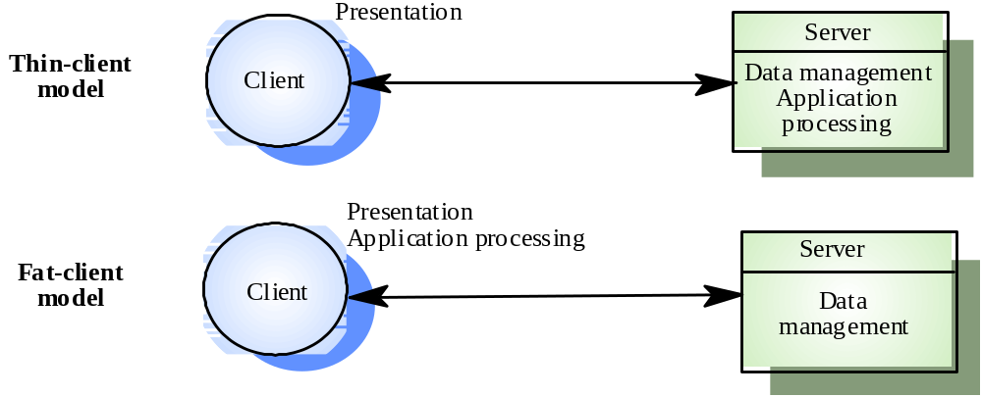
Thin and fat clients

Slide 19
Thin client model
Used when legacy systems are migrated to client server architectures.
  The legacy system acts as a server in its own right with a graphical interface implemented on a client
A major disadvantage is that it places a heavy processing load on both the server and the network
The model may also be implemented when the clients are simple network devices rather than PCs or workstations

Slide 20
Fat client model
More processing is delegated to the client as the application processing is locally executed
Most suitable for new C/S systems where the capabilities of the client system are known in advance
More complex than a thin client model especially for management. New versions of the application have to be installed on all clients (a major cost)

Slide 21
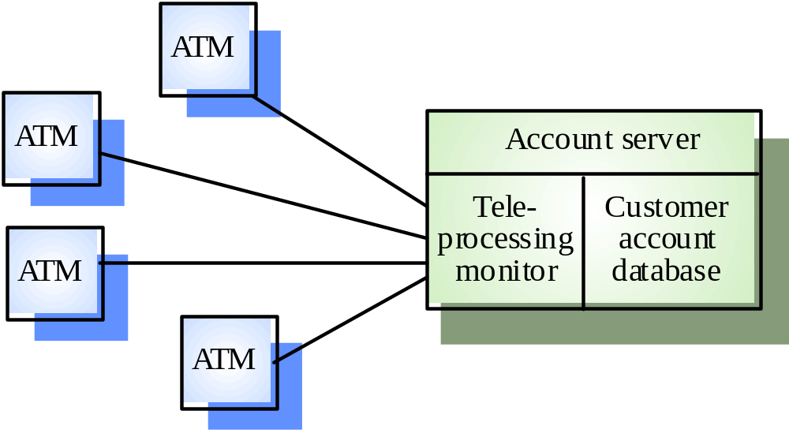
A client-server ATM system

Slide 22
Three-tier architectures
In a three-tier architecture, each of the application architecture layers may execute on a separate processor
Allows for better performance than a thin-client approach and is simpler to manage than a fat-client approach
A more scalable architecture - as demands increase, extra servers can be added

Slide 23
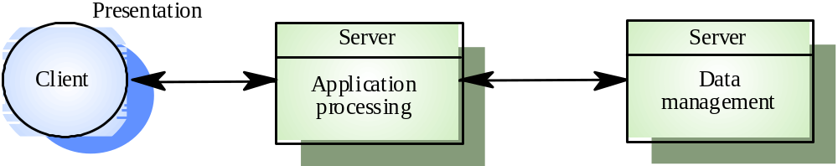
A 3-tier C/S architecture

Slide 24
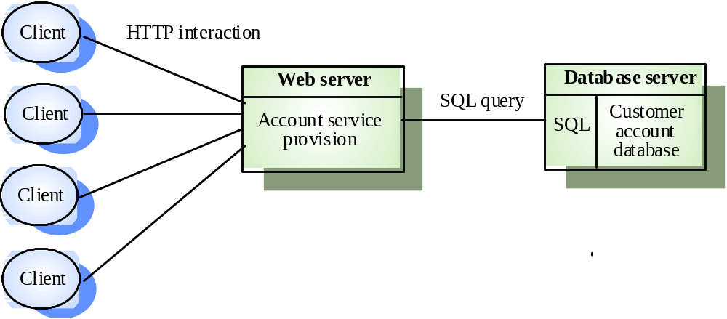
An internet banking system
efficient middleware

Slide 25
Use of C/S architectures
Arc
hit
ec
tu
re
A
ppli
cat
i
o
ns
T
wo-
ti
e
r
C/
S
L
egacy
sy
s
t
em
app
li
ca
ti
on
s
whe
r
e
sep
a
ra
ti
ng
app
li
ca
ti
on
a
r
ch
it
ec
t
u
r
e
w
i
t
h
p
r
oces
si
ng
a
nd
da
t
a
m
anage
m
en
t i
s
i
m
p
r
ac
ti
c
a
l
t
h
i
n c
li
en
ts
Co
m
pu
t
a
ti
ona
ll
y
-i
n
t
ens
i
ve
app
li
ca
ti
ons
su
c
h
a
s
co
m
p
il
e
r
s
w
it
h
litt
l
e
o
r
no
da
t
a
m
a
nage
m
en
t
Da
t
a
-i
n
t
ens
i
v
e
app
li
ca
ti
on
s
(
bro
w
s
i
ng
a
nd
que
r
y
i
ng)
w
it
h
littl
e
o
r
no
app
li
ca
ti
on p
r
oce
s
s
i
ng
.
T
wo-
ti
e
r
C/
S
App
li
ca
ti
on
s
whe
r
e
app
li
ca
ti
on p
r
oce
s
s
i
ng
i
s p
r
ov
i
ded
by
a
r
ch
it
ec
t
u
r
e
w
i
t
h
CO
TS
(
e
.
g. M
i
c
r
oso
ft
E
xce
l)
on
t
he
c
l
ie
nt
f
a
t
c
li
en
ts
App
li
ca
ti
on
s
whe
r
e
co
m
pu
t
a
ti
ona
ll
y-
i
n
t
en
si
ve p
r
oce
s
s
i
ng
of
da
t
a
(
e
.g
.
da
t
a
v
i
sua
lis
a
ti
on)
i
s
requ
ir
ed
.
App
li
ca
ti
on
s
w
it
h
r
e
l
a
ti
ve
l
y
s
t
ab
l
e
end
-
use
r
f
unc
ti
ona
lit
y u
s
ed
we
ll
-
e
s
t
ab
li
sh
e
d
s
i
n
a
n
env
ir
on
m
en
t
w
it
h
ys
t
e
m
ma
nage
m
en
t
T
hre
e
-
ti
e
r
o
r
L
arg
e
s
ca
l
e
app
l
i
c
a
ti
ons
w
i
th
hund
r
eds
or
t
housand
s
o
f
c
li
en
t
s
m
u
lti
-
ti
e
r
C/
S
App
li
ca
ti
on
s
whe
r
e
bo
t
h
t
he
da
t
a
a
nd
t
he
app
li
ca
ti
on
a
re
a
r
ch
it
ec
t
u
r
e
vo
l
a
til
e.
App
li
ca
ti
on
s
whe
r
e
da
t
a
fr
o
m
m
u
lti
p
l
e
s
our
c
es a
r
e
i
n
t
eg
r
a
t
ed

Slide 26
Distributed object architectures
There is no distinction in a distributed object architectures between clients and servers
Each distributable entity is an object that provides services to other objects and receives services from other objects
Object communication is through a middleware system called an object request broker (software bus)
However, more complex to design than C/S systems

Slide 27
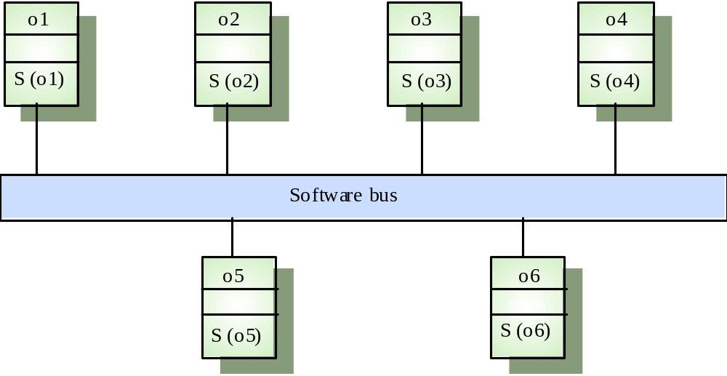
Distributed object architecture

Slide 28
Advantages of distributed object architecture
It allows the system designer to delay decisions on where and how services should be provided
It is a very open system architecture that allows new resources to be added to it as required. Software bus standards allow objects written in different programming languages to communicated and to provide services to each other
The system is flexible and scaleable
It is possible to reconfigure the system dynamically with objects migrating across the network as required

Slide 29
Uses of distributed object architecture
As a logical model that allows you to structure and organise the system. In this case, you think about how to provide application functionality solely in terms of services and combinations of services
As a flexible approach to the implementation of client-server systems. The logical model of the system is a client-server model but both clients and servers are realised as distributed objects communicating through a software bus

Slide 30
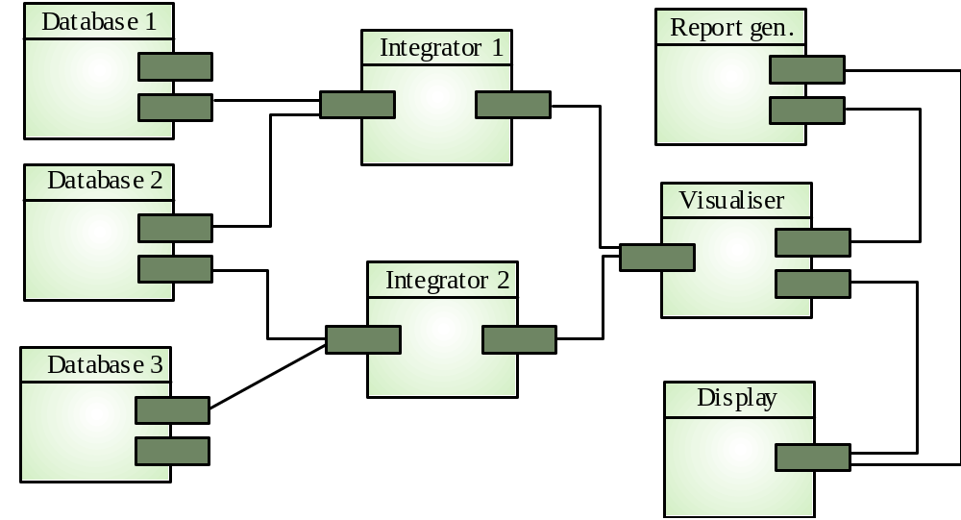
A data mining system

Slide 31
Data mining system
The logical model of the system is not one of service provision where there are distinguished data management services
It allows the number of databases that are accessed to be increased without disrupting the system
It allows new types of relationship to be mined by adding new integrator objects

Slide 32
CORBA(Common Object Request Broker Architecture)
CORBA is an international standard for an Object Request Broker - middleware to manage communications between distributed objects
Several implementation of CORBA are available
< Two principal standards >
CORBA(common object request broker architecture) has been defined by the Object Management Group(OMG)
OMG is a consortium of companies including Sun, HP and IBM
DCOM(Distributed Component Object Model) is an alternative approach by Microsoft to object request brokers

Slide 33
Distributed application structure
Application objects
Standard objects, defined by the OMG, for a specific domain e.g. insurance, e-commerce
Fundamental CORBA services such as directories and security management
Horizontal (i.e. cutting across applications) facilities such as user interface facilities

Slide 34
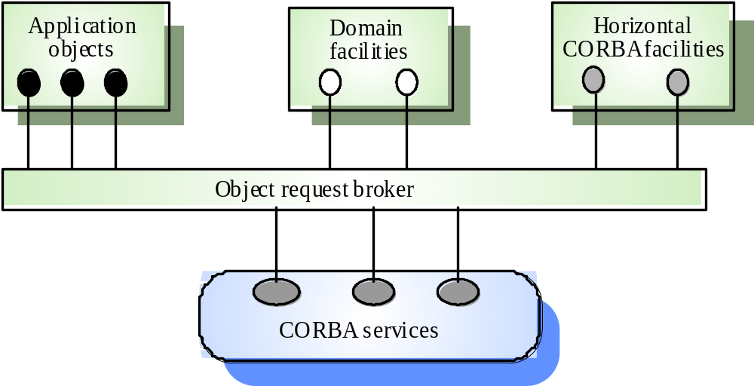
CORBA application structure

Slide 35
CORBA standards : major elements
An object model for application objects
  A CORBA object is an encapsulation of state with a well-defined, language-neutral interface defined in an IDL (interface definition language)
An object request broker(ORB) that manages requests for object services
A set of general object services of use to many distributed applications
A set of common components built on top of these services

Slide 36
CORBA objects
CORBA objects are comparable, in principle, to objects in C++ and Java
They MUST have a separate interface definition that is expressed using a common language (IDL) similar to C++
There is a mapping from this IDL to programming languages (C++, Java, etc.)
Therefore, objects written in different languages can communicate with each other

Slide 37
Object request broker (ORB)
The ORB handles object communications. It knows of all objects in the system and their interfaces
Using an ORB, the calling object binds an IDL stub that defines the interface of the called object
Calling this stub results in calls to the ORB which then calls the required object through a published IDL skeleton that links the interface to the service implementation

Slide 38
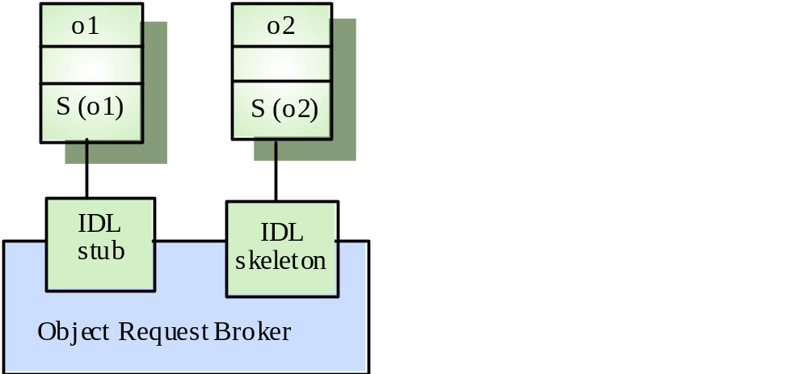
ORB-based object communications

Slide 39
Inter-ORB communications
ORBs are not usually separate programs but are a set of objects in a library that are linked with an application when it is developed
ORBs handle communications between objects executing on the sane machine
Several ORBS may be available and each computer in a distributed system will have its own ORB
Inter-ORB communications are used for distributed object calls

Slide 40
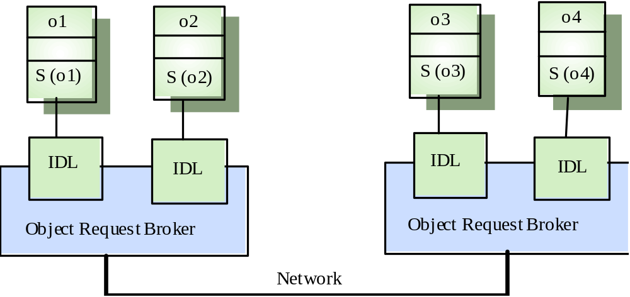
Inter-ORB communications

Slide 41
CORBA services
Naming and trading services
  These allow objects to discover and refer to other objects on the network
Notification services
  These allow objects to notify other objects that an event has occurred
Transaction services
  These support atomic transactions and rollback on failure

Slide 42
Key points
Almost all new large systems are distributed systems
Distributed systems support resource sharing, openness, concurrency, scalability, fault tolerance and transparency
Client-server architectures involve services being delivered by servers to programs operating on clients
User interface software always runs on the client and data management on the server

Slide 43
Key points
In a distributed object architecture, there is no distinction between clients and servers
Distributed object systems require middleware to handle object communications
The CORBA standards are a set of middleware standards that support distributed object architectures

